Slide 1
CUSTOM EXCEPTION HANDLING

Slide 2
Objectives
Understand custom exception handling class
How to use it to throw custom exceptions

Slide 3
Custom Exception Class
Exception class can be created by user.
It is needed whenever you need to tackle a situation for which there is no system exception available
Such as, you are writing an application through which an user is entering his/her age while filling up details for online insurance policy application form and you want an exception to be thrown when the user enters age which is less than permitted minimum age for the policy. But, there is no system exception available for this purpose.
In this situation you need to create a custom exception class, such as AgeLessThanFiveException

Slide 4
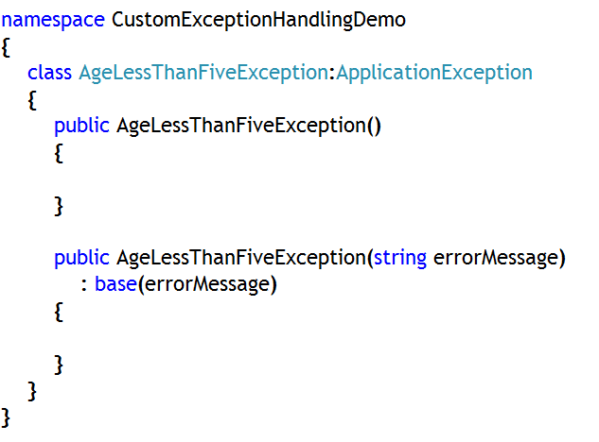
How to create custom exception class?
Technique: 1
Create a custom exception class by extending from ApplicationException class, which inherits from base class Exception.
Provide user-defined (overloaded constructors) which will accept error message as string data type and pass to base class using base keyword

Slide 5
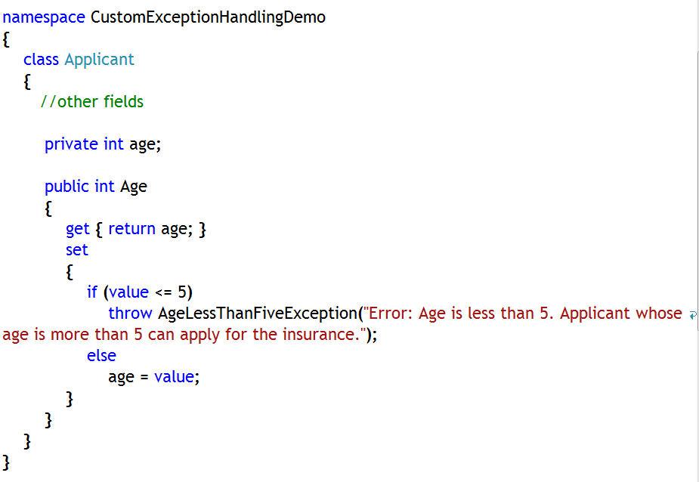
How to throw custom exception?
User has to throw custom exception, since runtime is unaware about custom exception class
Create an object of custom exception class wherever necessary.
Use ‘throw’ keyword to throw the exception object

Slide 6
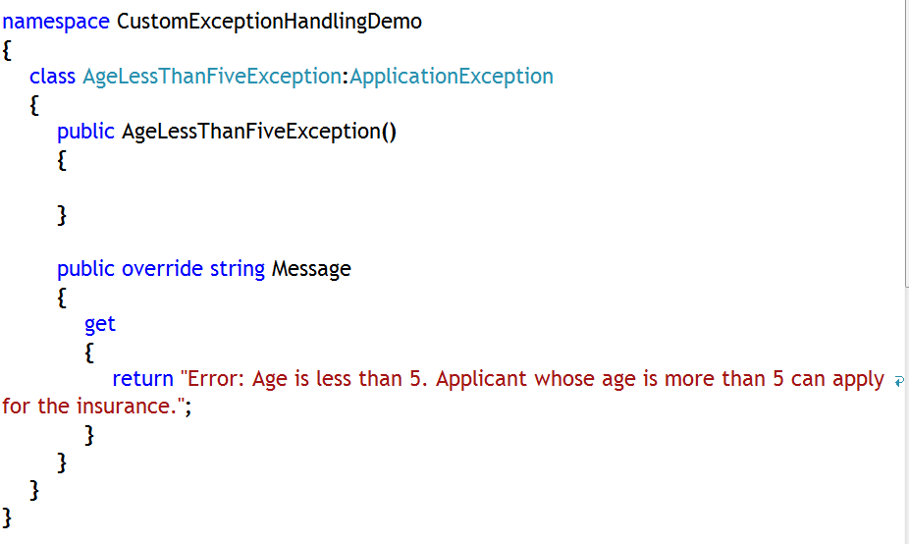
How to create custom exception class?
Technique: 2
Create a custom exception class by extending from ApplicationException class, which inherits from base class Exception.
Override virtual, read-only ‘Message’ property from base class and return custom message from that property

Slide 7
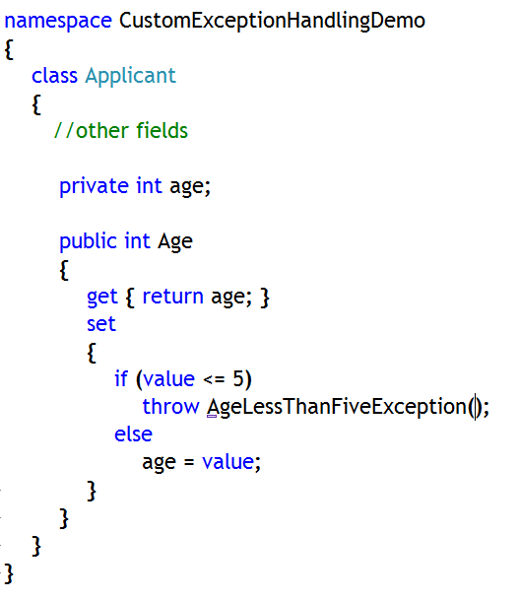
How to throw custom exception?
User has to throw custom exception, since runtime is unaware about custom exception class
Create an object of custom exception class where ever necessary.
Use ‘throw’ keyword to throw the exception object

Slide 8
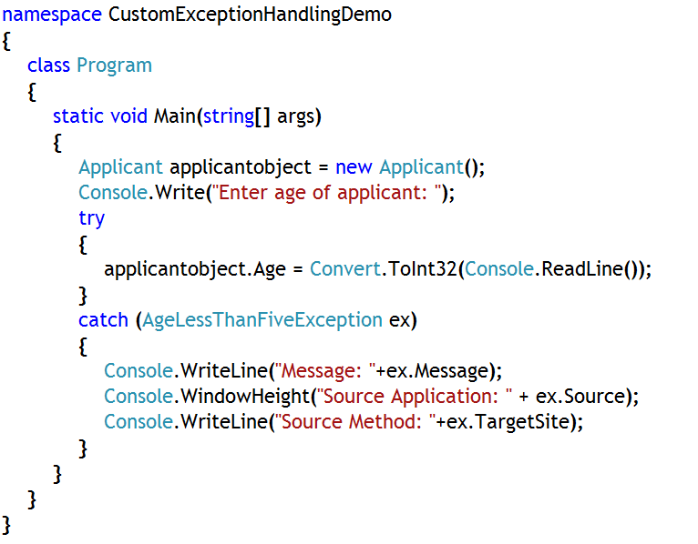
How to catch custom exception?
Catching custom exception is in no way different from catching any system exception
Put the suspected code in try block
Use catch block with custom exception class variable to catch the custom exception
Display necessary information

Slide 9
The throw Statement
Use ‘throw’ statement to throw an appropriate exception
Generally used to throw custom exceptions
Give the exception a meaningful message
throw expression ;
Custom Exception class
if (minute < 1 || minute >= 60) {
throw new InvalidTimeException(minute +
" is not a valid minute“);
// !! Not reached !!
}

Slide 10
Reference
For more details, please visit
http://msdn.microsoft.com/en-us/library/87cdya3t(v=vs.110).aspx
http://www.tutorialspoint.com/csharp/csharp_exception_handling.htm
http://visualcsharptutorials.com/fundamentals/user-defined-exceptions
Notes:
Reference

